Slide 1

#FigTag
Find Papers with the Data You’re Looking For!

Slide 2

The Team
Meng Cheng
Ryan Connor
Marie Gallagher
Alex Kotliarov
David Shao
Ricardo Villamarin

Slide 3

The Problem
As a researcher:
I look for articles in pubmed
That have data that speak to a hypothesis or problem I have
BUUUUUUT …
What I get
Lots of articles that contain my keywords but with few figures about data “with” all my keywords

Slide 4
The Solution: Index Papers based on Figure Attributes
Image Processing
Text Mining
Split Multipanel Figures
Extract Text from Figures
Cluster and Classify Figures
Map text to MeSH Hierarchy
Sources
Figure Legend
Related Material & Methods
Relevant Results

Slide 5
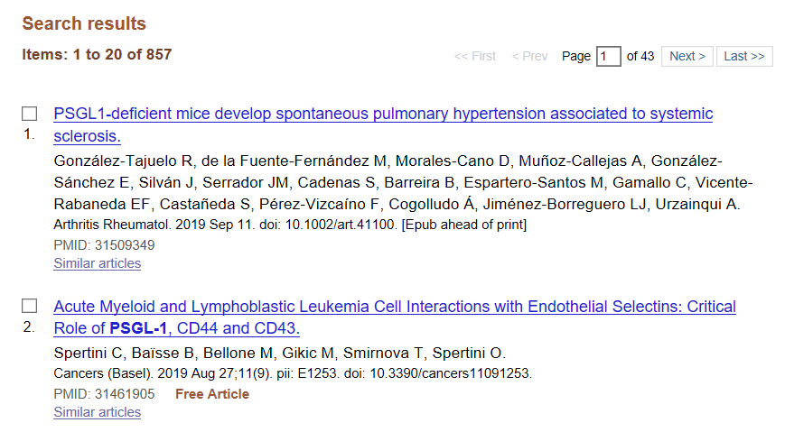
PSGL-1[data fig]
Figs 1,3 of 5
Figs 2 of 4

Slide 6
Development Pipeline
Open-i
PSGL-1 Query
Image Set
Image
Caption
Variational Autoencoder
Based Classification
Multipanel Image Splitting
MeSH Indexing of Figure Legends
Clusters of Images
Individual Figure
List of MeSH Terms

Slide 7
Product Pipeline
Multipanel Image Splitting
Variational Autoencoder
Based Classification
Individual Figure
SubFig ID
Image
Class
Image + Legend
Metadata
(for indexing)
Caption
MeSH Indexing of Figure Legends
MeSH Terms

Slide 8

Split multi-panel figure
Why?
Better input for image clustering
More granular mesh indexing for individual sub image
How?
Use OpenCV library
Horizontal/Vertical projection
Assume sub panels are arranged in grid

Slide 9
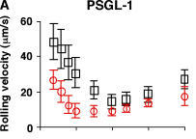
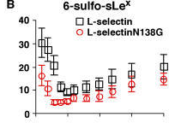
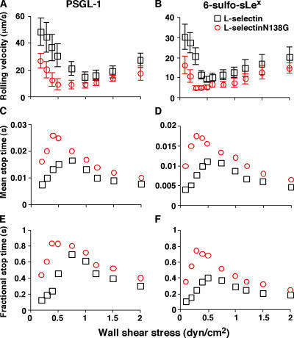
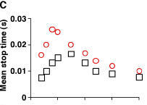
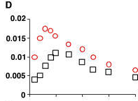
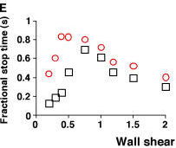
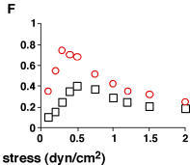
Work when sub panels are arranged in grid

Slide 10
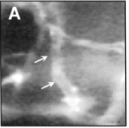
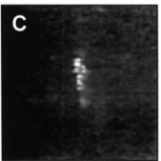
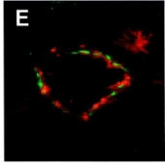
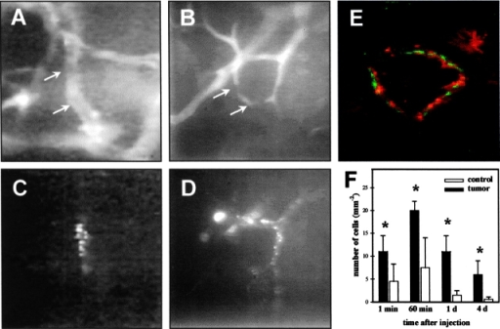
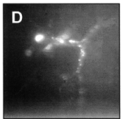
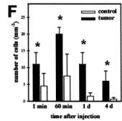
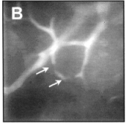
Heterogeneous sub panels
Notice now the bar chart F is a separate image

Slide 11
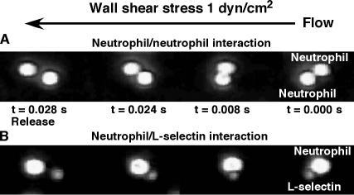
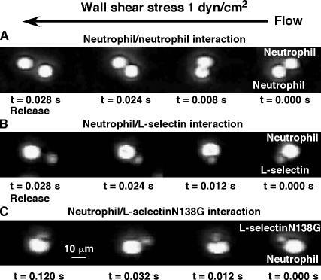
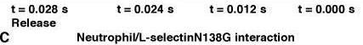
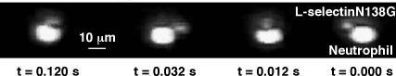
Cut at the wrong places!
Sub panels and labels are not well separated

Slide 12
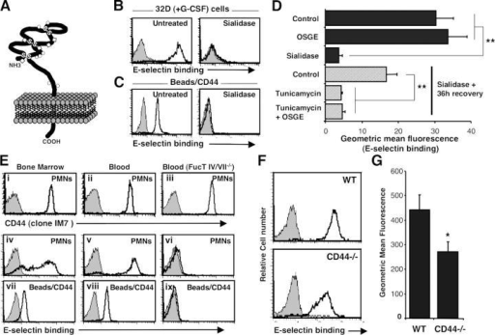
Does not detect sub panels if they are not aligned

Slide 13
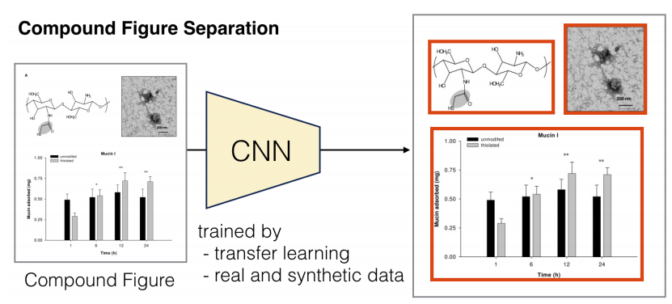
Potential Improvement
Use AI/ML methods to detect and split multi-panel figures.
E.g. A Data Driven Approach for Compound Figure Separation Using Convolutional Neural Networks (Tsutsui, et al, 2017)

Slide 14
Mesh term indexer
MTI
(Medical Text Indexer)
Figure Captions
Mesh Terms
Male
Mice
Animals
Humans
SELP protein, human
P-Selectin
Blood Platelets
DNA Primers
Ligands
Membrane Glycoproteins
... …
Affinity isolation of PSGL-1 glycoprotein from
platelets and neutrophils. (A) Purified preparations
of neutrophils or platelets were biotinylated and lysed.
Cell lysates were incubated with P-selectinIgG … …

Slide 15
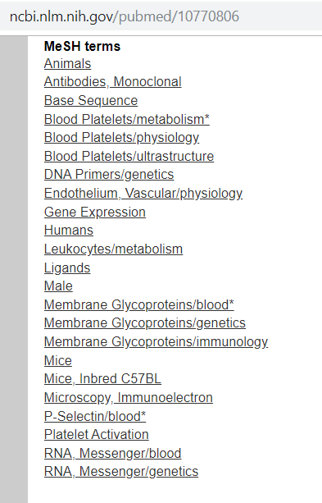


"MeSH": {
"minor": [
"Animals",
"Antibodies, Monoclonal",
"Base Sequence",
"DNA Primers/genetics",
"Endothelium, Vascular/physiology",
"Gene Expression",
"Humans",
"Leukocytes/metabolism",
"Ligands",
"Male",
"Mice",
"Mice, Inbred C57BL",
"Microscopy, Immunoelectron",
"Platelet Activation",
"RNA, Messenger/blood/genetics"
],
"major": [
"Blood Platelets/metabolism*/physiology/ultrastructure",
"Membrane Glycoproteins/blood*/genetics/immunology",
"P-Selectin/blood*"
]
},
MeSH terms associated with article
Article’s MeSH terms snippet from the Open-i API

Slide 16
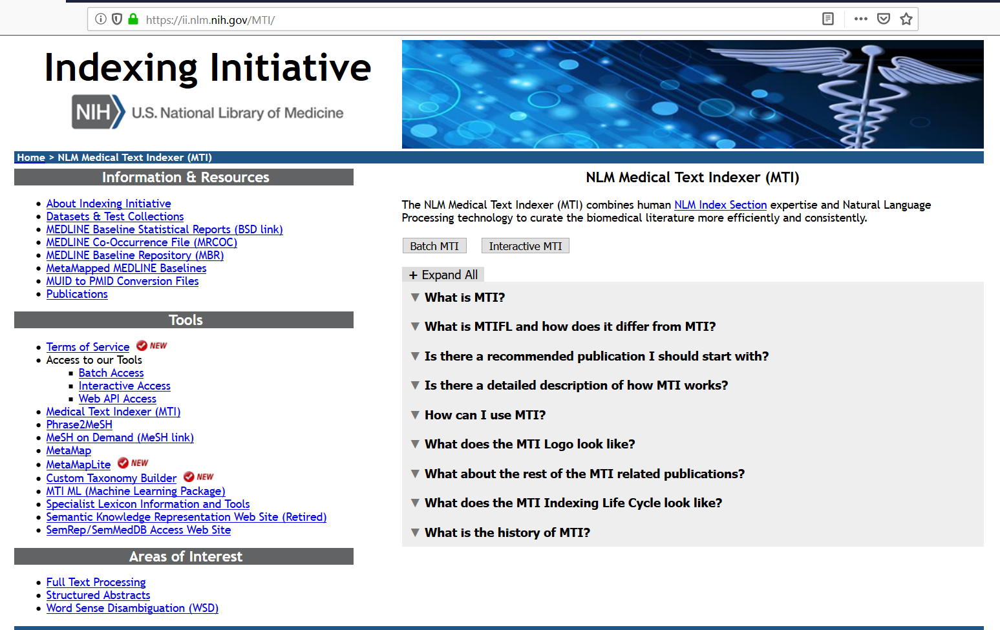
Indexing Initiative’s NLM Medical Text Indexer Tools generated MeSH headings for each Caption in our dataset
Used MTI Batch Access first. Used MTI Interactive Access later.

Slide 17
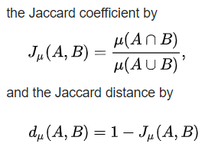
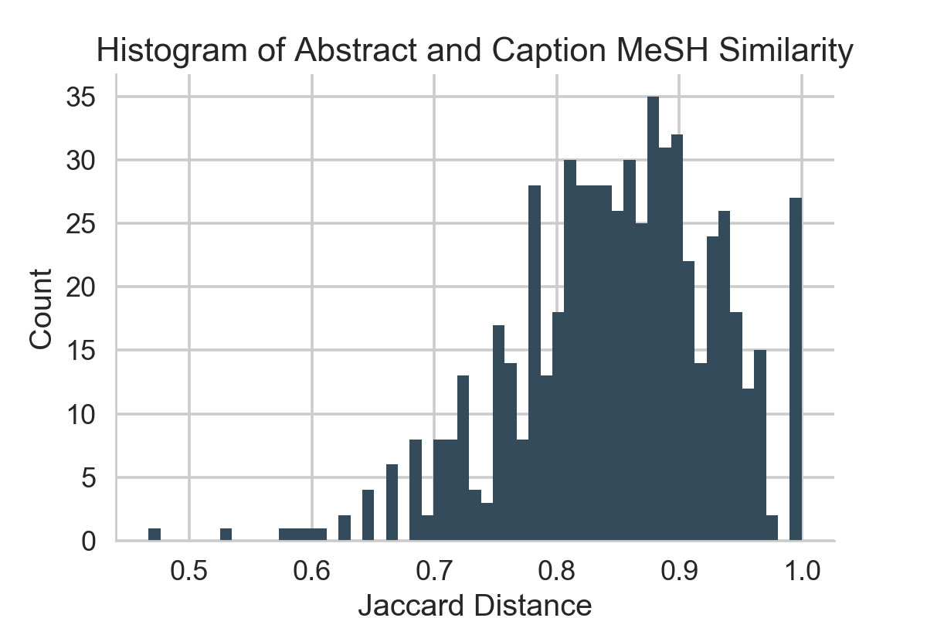
MeSH Indexing of Figure Legends Adds Value!
1115 Figures from 371 Papers
615 Figure for which both source paper and caption have MeSH terms (~55%)
588 Figures with at least 1 MeSH term in common between article and caption (~96%)

Slide 18

Machine-Learning for Image Classification
Variational Autoencoder ==

Slide 19
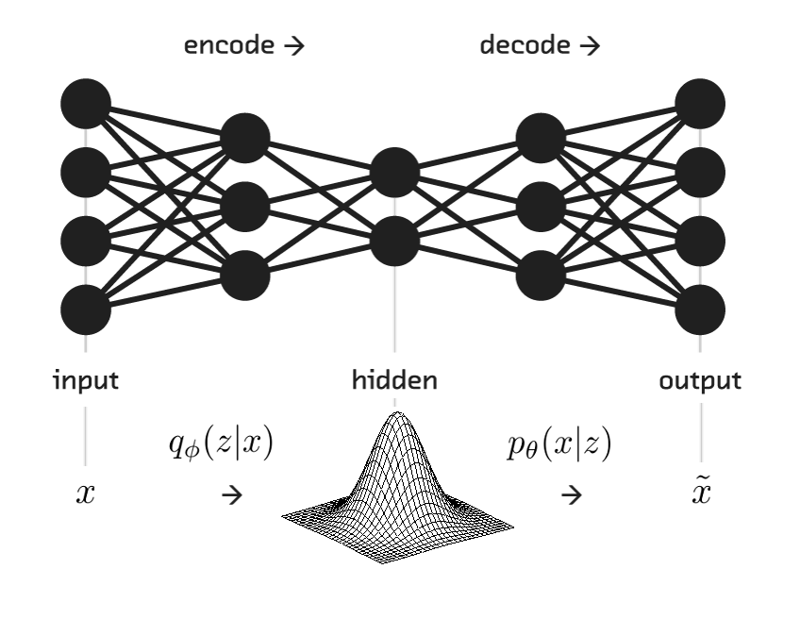
What does Magic look like?
In English?
Variation Autoencoder model consists of encoder, decoder and a loss function.
Encoder is a neural network that outputs a latent representation of an image - features of an image that represent a point in the D-dimentional feature space; The encoder serves as inference model.
Decoder is a neural network that learns to reconstruct the data - input image - given its representation (latent variables).
We will produce features vector for each image of a training set and will use these features to fit a KMeans clustering model and decide on number of clusters using "elbow" heuristic.
Notes:
Latent space – img 100x100, feature space 256, 30 epochs, done in google colab

Slide 20
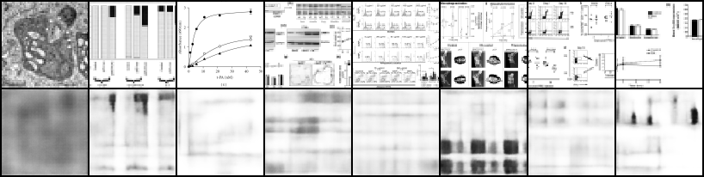
Example Decoder Output

Slide 21
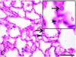
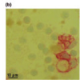
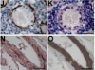
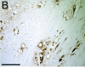
Example Clusters

Slide 22
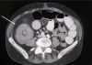
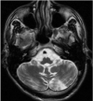
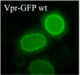
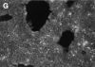
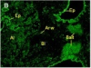
Example Clusters

Slide 23
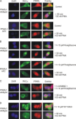
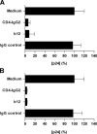
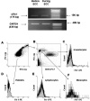
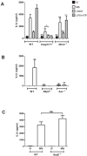
Example Clusters

Slide 24

Thank You
Questions? Comments? Suggestions?

Slide 25
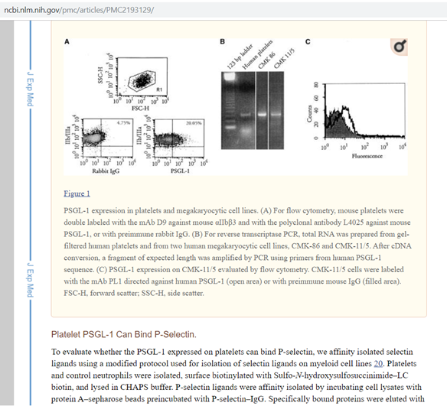
"uid": "PMC2193129",
"pmcid": "2193129",
"pmid": "10770806",
"docSource": "PMC",
"articleType": "ra",
"pmc_url": "http://www.ncbi.nlm.nih.gov/pmc/articles/PMC2193129",
"pubMed_url": "http://www.ncbi.nlm.nih.gov/pubmed/10770806",
"image": {
"id": "F1",
"caption": "<b>PSGL-1<\/b> expression in platelets and megakaryocytic cell lines. (A) For flow cytometry, mouse platelets were double labeled with the mAb D9 against mouse αIIbβ3 and with the polyclonal antibody L4025 against mouse <b>PSGL-1<\/b>, or with preimmune rabbit IgG. (B) For reverse transcriptase PCR, total RNA was prepared from gel-filtered human platelets and from two human megakaryocytic cell lines, CMK-86 and CMK-11/5. After cDNA conversion, a fragment of expected length was amplified by PCR using primers from human <b>PSGL-1<\/b> sequence. (C) <b>PSGL-1<\/b> expression on CMK-11/5 evaluated by flow cytometry. CMK-11/5 cells were labeled with the mAb PL1 directed against human <b>PSGL-1<\/b> (open area) or with preimmune mouse IgG (filled area). FSC-H, forward scatter; SSC-H, side scatter."
},
"imgThumb": "/imgs/100/60/2193129/PMC2193129_JEM991708.f1.png",
"imgLarge": "/imgs/512/60/2193129/PMC2193129_JEM991708.f1.png",
"imgThumbLarge": "/imgs/137/60/2193129/PMC2193129_JEM991708.f1.png",
"imgGrid150": "/imgs/150/60/2193129/PMC2193129_JEM991708.f1.png",
"similarInCollection": "/search?simCollection=PMC2193129_JEM991708.f1&query=psgl-1%20OR%20sleplg&req=3",
"getArticleFigures": "/search?uid=PMC2193129&req=5",
"detailedQueryURL": "/search?img=PMC2193129_JEM991708.f1&query=psgl-1%20OR%20sleplg&it=x,u,ph,p,mc,m,g,c&coll=pmc&req=4",
"similarInResults": "/search?simResults=PMC2193129_JEM991708.f1&query=psgl-1%20OR%20sleplg&it=x,u,ph,p,mc,m,g,c&coll=pmc&req=2"
Caption snippet from the Open-i API

Slide 26
PMC2193129_JEM991708.f1|PSGL-1 expression in platelets and megakaryocytic cell lines. (A) For flow cytometry, mouse platelets were double labeled with the mAb D9 against mouse αIIbβ3 and with the polyclonal antibody L4025 against mouse PSGL-1, or with preimmune rabbit IgG. (B) For reverse transcriptase PCR, total RNA was prepared from gel-filtered human platelets and from two human megakaryocytic cell lines, CMK-86 and CMK-11/5. After cDNA conversion, a fragment of expected length was amplified by PCR using primers from human PSGL-1 sequence. (C) PSGL-1 expression on CMK-11/5 evaluated by flow cytometry. CMK-11/5 cells were labeled with the mAb PL1 directed against human PSGL-1 (open area) or with preimmune mouse IgG (filled area). FSC-H, forward scatter; SSC-H, side scatter.
Input to MTI (Identifier | Caption)
PMC2193129_JEM991708.f1|Humans|C0086418|156604
PMC2193129_JEM991708.f1|Mice|C0026809|156604
PMC2193129_JEM991708.f1|Rabbits|C3887509|156604
PMC2193129_JEM991708.f1|Animals|C0003062|156604
PMC2193129_JEM991708.f1|DNA, Complementary|C0006556|81641
PMC2193129_JEM991708.f1|Blood Platelets|C0005821|45514
PMC2193129_JEM991708.f1|Reverse Transcriptase Polymerase Chain Reaction|C0599161|40552
PMC2193129_JEM991708.f1|Flow Cytometry|C0016263|37414
PMC2193129_JEM991708.f1|DNA Primers|C0206416|155604
PMC2193129_JEM991708.f1|Megakaryocytes|C0025166|87831
PMC2193129_JEM991708.f1|Polymerase Chain Reaction|C0032520|45810
PMC2193129_JEM991708.f1|Cell Line|C0007600|11652
PMC2193129_JEM991708.f1|Immunoglobulin G|C0020852|1000
PMC2193129_JEM991708.f1|RNA|C0035668|1000
Output from MTI (includes Identifier and MeSH heading)

Slide 27
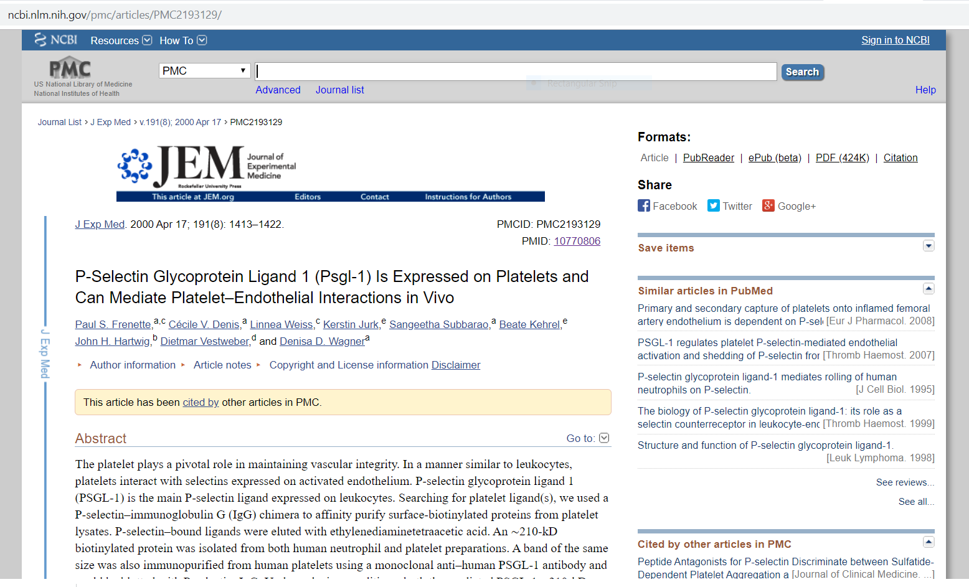

Full text article in PubMed Central (PMC)
Figure and caption in full text article

